Slide 1


Department of ECE
LEARNATHON
PROJECT TITLE: Driver Behaviour &Vehicle Tracking
System using Raspberry Pi
Presented by:
P. Ravi teja - 2300049180
D. Guna sekhar - 2300049125
G. Dinesh - 2300049222
V. Jagannadha naga sai - 2300049027
Guided by:
DR.A.V.PRABHU

Slide 2



AIM OF THE PROJECT
Aim: To design and implement a real-time Driver Behaviour and Vehicle Tracking System using Raspberry Pi that monitors driving patterns (such as over-speeding, harsh braking, sudden acceleration, and rash turning) and tracks the live location of the vehicle using GPS technology, in order to improve road safety and enable remote vehicle monitoring.
PROBLEM STATEMENT:-
Road accidents are increasing due to rash driving, over-speeding, and careless driver behavior.
Vehicle owners and fleet managers lack real-time information about vehicle location and driving style.
There is no immediate alert system to warn authorities or vehicle owners during unsafe driving.
Monitoring multiple vehicles manually is time-consuming and inefficient.
Lack of stored driving data makes it difficult to analyze driver performance over time.
Hence, there is a need for a low-cost, real-time driver behavior monitoring and vehicle tracking system using Raspberry Pi.

Slide 3
LIST OF THE COMPONENTS
HARDWARE COMPONENTS REQUIRED:
Raspberry Pi 4 Model B
MicroSD Card (16GB or higher)
5V 3A Power Supply (for Raspberry Pi)
USB Camera / Pi Camera Module
HC-SR04 Ultrasonic Sensor
SW-420 Vibration Sensor Module
MPU6050
16x2 LCD Display with I2C Module (PCF8574)
Buzzer (5V Active Buzzer)

Slide 4
LIST OF THE COMPONENTS
SOFTWARE REQUIRED:-
Raspberry Pi OS
Python
OpenCV (cv2)
MediaPipe
NumPy
RPi.GPIO Library
mpu6050 Python Library
RPLCD Library (for I2C LCD)
Requests Library (for Telegram alerts)
Socket Programming (Python built-in library)
Telegram Bot API

Slide 5
ABSTRACT
Road accidents are one of the major causes of injuries and fatalities worldwide, often resulting from unsafe driving practices such as over-speeding, sudden braking, and rash turning. To address this issue, the proposed project presents a Driver Behaviour and Vehicle Tracking System using the Raspberry Pi as the main processing unit. The system continuously monitors driving patterns using motion sensors such as an accelerometer and gyroscope, and tracks the real-time location of the vehicle using a GPS module.
The collected data is analyzed to detect abnormal driving behaviors like rapid acceleration, harsh braking, and sharp turns. In case of unsafe conditions, alerts can be sent to the vehicle owner or fleet manager through GSM or internet connectivity. Additionally, the system stores driving data for future analysis and performance evaluation.
This project aims to provide a low-cost, efficient, and real-time safety solution that enhances road safety, improves driver accountability, and enables effective vehicle monitoring for individuals and fleet management systems.

Slide 6
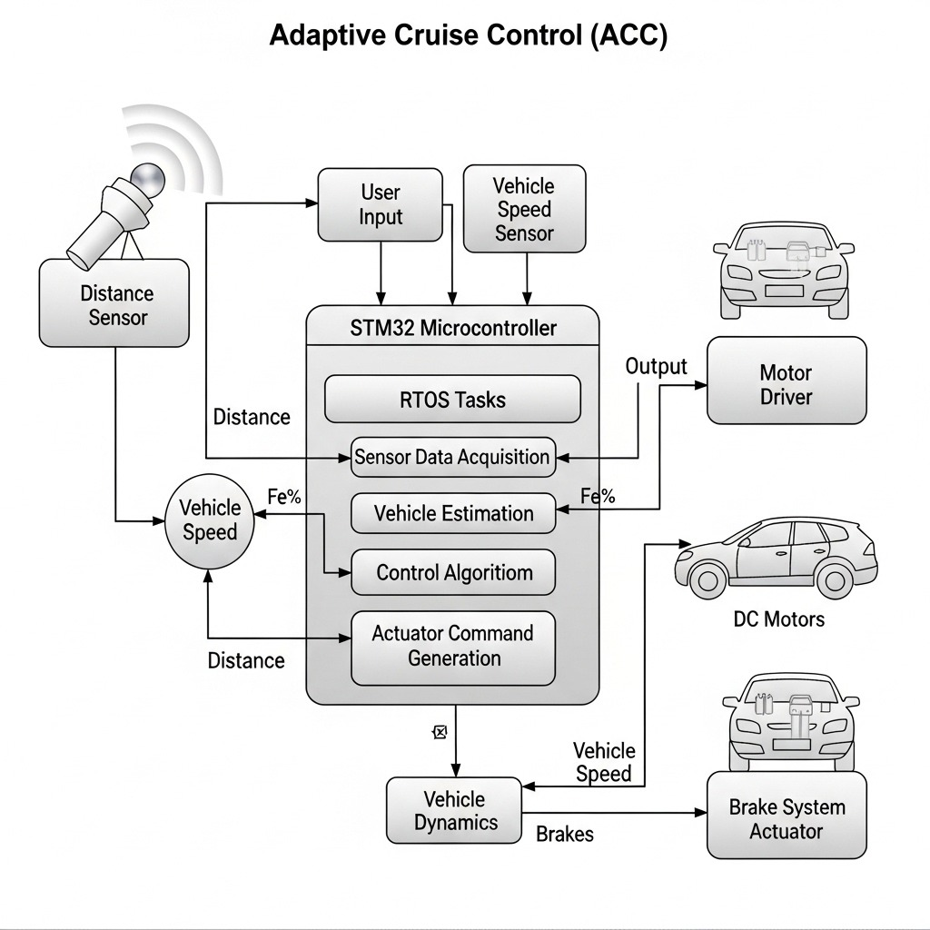
BLOCK DIAGRAM

Slide 7
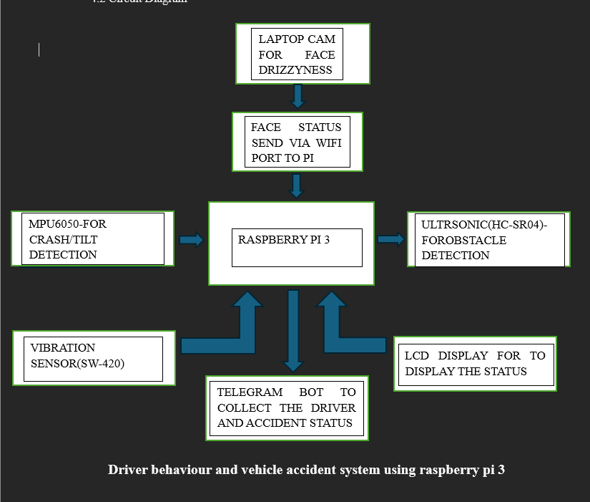
BLOCK DIAGRAM

Slide 8
WORKING
1. Sensor Data Acquisition: Motion sensors like accelerometer and gyroscope continuously monitor vehicle movement. They detect sudden acceleration, harsh braking, and sharp turns. A GPS module collects real-time location coordinates of the vehicle.
2. Data Processing by Raspberry Pi: The Raspberry Pi receives data from sensors through communication interfaces. It processes the data using predefined threshold values. Unsafe driving behaviors are identified based on abnormal readings.
3. Vehicle Location Tracking: The GPS module provides latitude and longitude information. The Raspberry Pi converts this data into readable location format. The vehicle’s position can be viewed on a monitoring dashboard or map.
4. Alert Generation System: If abnormal driving is detected, the system triggers an alert. Notifications are sent via GSM module (SMS) or internet-based services. This ensures immediate information to the vehicle owner or manager.
5. Data Storage and Analysis: All driving behavior and location data are stored in a database. The stored data can be reviewed for driver performance evaluation. Reports help in improving safety and monitoring efficiency.

Slide 9
FUTURE SCOPE & ITS APPLICATIONS
1. Integration with AI & Machine Learning: The system can be enhanced using AI algorithms to predict accident-prone behavior. Machine learning models can classify driving patterns more accurately. This will improve real-time decision-making and safety recommendations.
2. Cloud-Based Advanced Analytics: Future versions can store data on cloud platforms for large-scale analysis. Fleet managers can monitor multiple vehicles through a centralized dashboard. Big data analysis can help in improving driver training programs.
3. Integration with Smart City Infrastructure: The system can be connected with traffic management systems. Real-time vehicle data can assist in reducing traffic congestion. It can support intelligent transportation systems (ITS) development.
4. Accident Detection & Emergency Response: Advanced sensors can detect collisions automatically. The system can send emergency alerts with live location to hospitals. This can reduce response time and save lives.
5. Mobile App & IoT Expansion: A dedicated mobile app can provide live tracking and driver reports. IoT integration can allow remote vehicle diagnostics. Over-the-air updates can improve system performance continuously.

Slide 10
CONCLUSION
The Driver Behaviour and Vehicle Tracking System developed using the Raspberry Pi provides an effective solution for improving road safety and vehicle monitoring. The system continuously observes driving patterns such as over-speeding, sudden braking, rapid acceleration, and sharp turns using motion sensors, while simultaneously tracking real-time vehicle location through GPS technology.
By analyzing sensor data and generating instant alerts during unsafe driving conditions, the system enhances driver accountability and reduces the risk of accidents. The ability to store and review historical data further supports performance evaluation and long-term safety improvements.
Overall, this project offers a low-cost, reliable, and scalable solution suitable for personal vehicles, fleet management, public transport, and logistics services. With future enhancements such as AI integration and cloud analytics, the system can play a significant role in building smarter and safer transportation systems.

Slide 11
TEAM MEMBERS DETAILS
Presented by:
P. Ravi Teja - 2300049180
D. Guna shaker - 2300049125
G. Dinesh - 2300049222
V. Jagannadha Naga Sai - 2300049027

Slide 12
THANK YOU
23SDEC06A– EMBEDDED DESIGN

